Slide 1
EEE Lecture-18

Slide 2
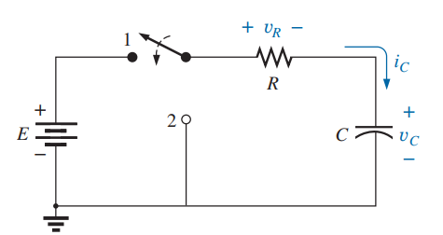
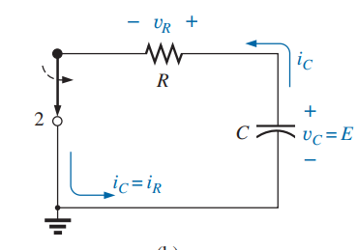
10.8 Discharge Phase
In Fig. 10.39(a), a second contact for the switch was added to the circuit to permit a controlled discharge of the capacitor.
With the switch in position 1, we have the charging network.
Following the full charging phase, if we move the switch to position 2, the capacitor can be discharged through the resulting circuit in Fig. 10.39(b).

Slide 3

10.8 Discharge Phase
Initially, the discharge current jumps to a relatively high value; then it begins to drop.
It drops with time because charge is leaving the plates of the capacitor, which in turn reduces the voltage across the capacitor (v_{c}) and also the voltage across the resistor (v_{R}) and the resulting current.
The equation for the decaying voltage(v_{c}) across the capacitor would be the following:
which employs the function e^{-x} and the same time constant used in the charging phase.

Slide 4
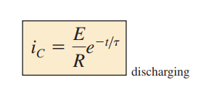
10.8 Discharge Phase
During the discharge phase, the current i_{C} will also decrease with time, as defined by the following equation:
The complete discharge will occur, for all practical purposes, in five time constants.

Slide 5
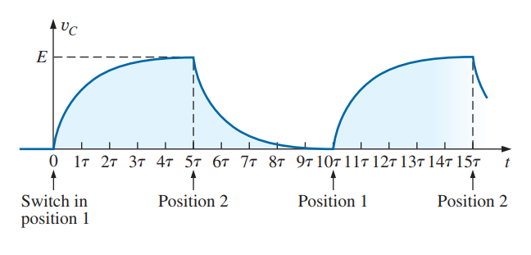
Since the polarity of v_{C} is the same for both the charging and the discharging phases, the entire curve lies above the axis.

Slide 6
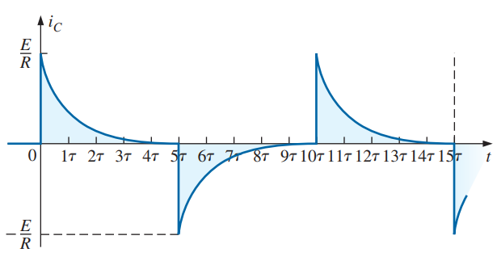
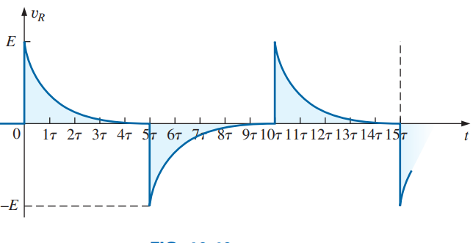
The current i_{C} reverses direction during the charging and discharging phases, producing a negative pulse for both the current and the voltage v_{R}.

Slide 7
10.8 Discharge Phase
Example: 10.6
Example: 10.7
Example: 10.8

Slide 8
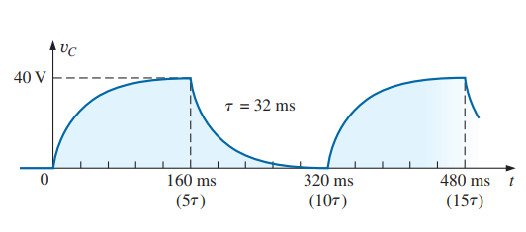
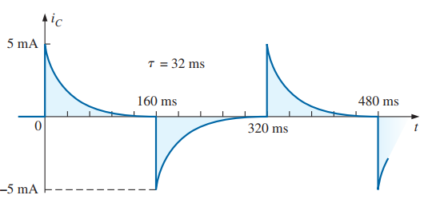
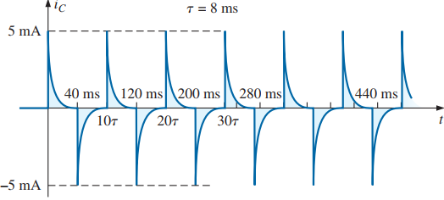
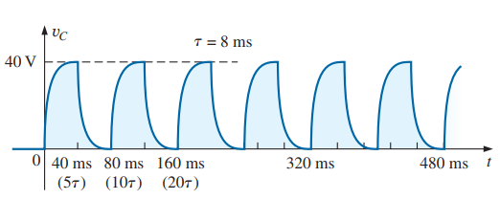
The Effect of τ on the Response
If the value of τ (=RC) were changed by changing the resistance(R), or the capacitance(C), or both, the resulting waveforms would appear the same because they were plotted against the time constant of the network.
If they were plotted against time (t), there could be a dramatic change in the appearance of the resulting plots.

Slide 9
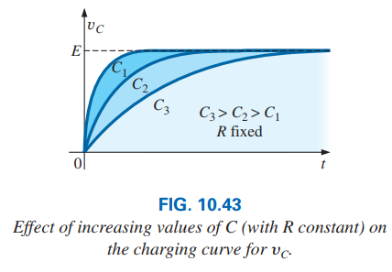
The Effect of τ on the Response
For a fixed-resistance network, the effect of increasing the capacitance is clearly demonstrated in Fig. 10.43.
The larger the capacitance, and hence the time constant, the longer it takes the capacitor to charge up (as it requires 5τ)—there is more charge to be stored.

Slide 10
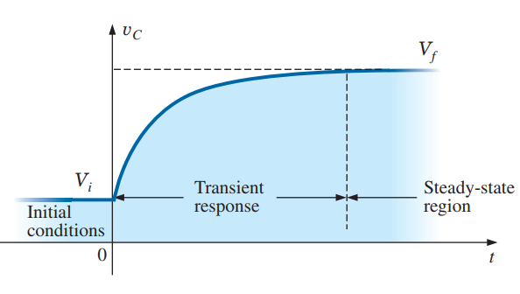
10.9 Initial Value
The voltage across the capacitor at the initial instant is called the initial value, as shown for the general waveform of Fig. 10.48.
Once the switch is thrown, the transient phase will commence until a leveling off occurs after five time constants.
After that, the region of relatively fixed value that follows the transient response is called the steady-state region, and the resulting value is called the steady-state or final value V_{f}.

Slide 11
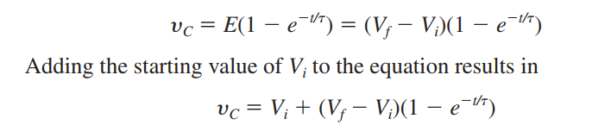
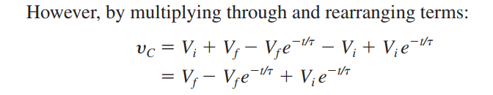

10.9 Initial Value
The steady-state value is found by substituting the open-circuit equivalent for the capacitor and finding the voltage across the plates.
For the transient period, the voltage rises from Vi (previously 0 V) to a final value of V_{f} . Therefore

Slide 12
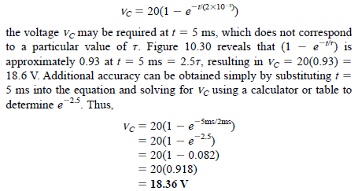
10.10 Instantaneous Value
On occasion it will be necessary to determine the voltage or current at a particular instant of time that is not an integral multiple of τ. For example, if

Slide 13

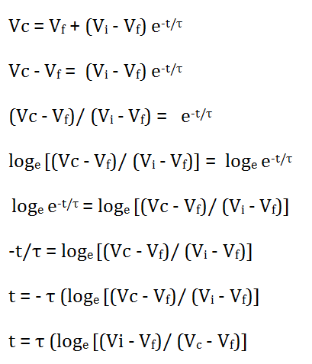
10.10 Instantaneous Value
There are also occasions when the time to reach a particular voltage or current is required.

Slide 14
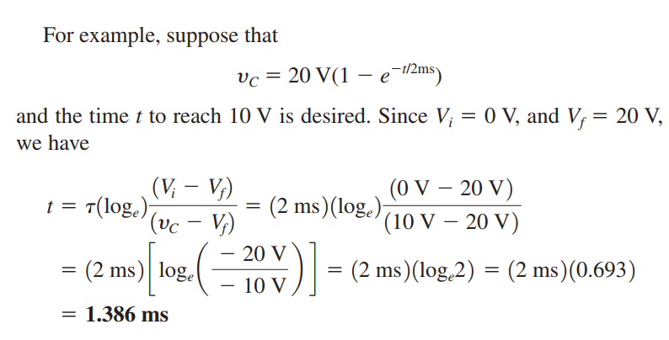
10.10 Instantaneous Value

Slide 15
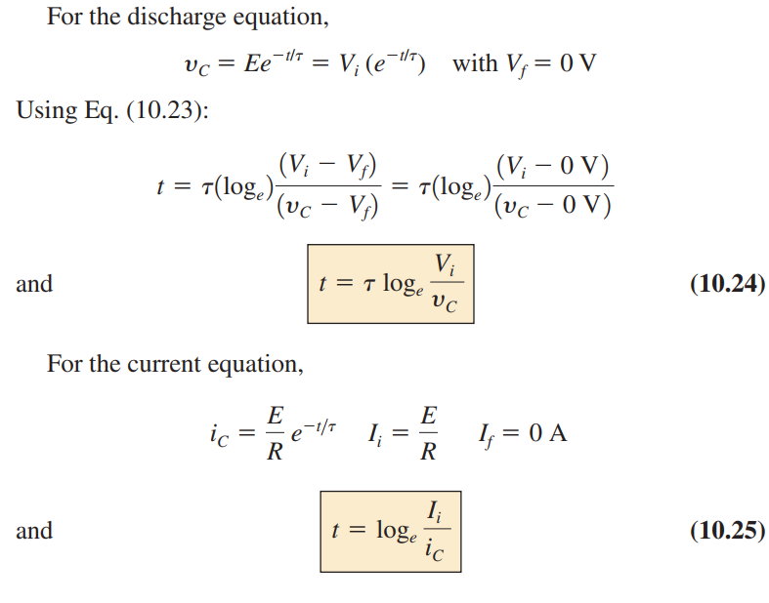
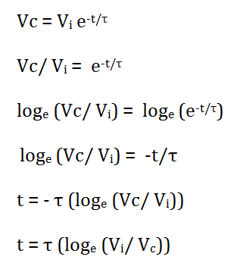

Slide 16
10.11 Thevenin Equivalent: τ = R_{Th}C
Occasions will arise in which the network does not have the simple series form. It will then be necessary first to find the Thévenin equivalent circuit for the network external to the capacitive element.
E_{Th} will then be the source voltage E, and R_{Th} will be the resistance R. The time constant is then τ = R_{Th}C.
Example: 10.10
Example: 10.11
Example: 10.12

Slide 17
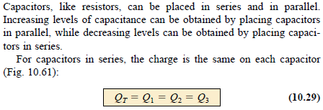
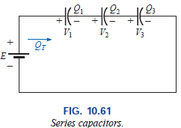
10.13 Capacitors in Series and Parallel
Then, Capacitors in Series all have the same current flowing through them as i_{c} = i₁ = i₂ = i₃ etc. Therefore each capacitor will store the same amount of electrical charge, Q on its plates regardless of its capacitance.

Slide 18
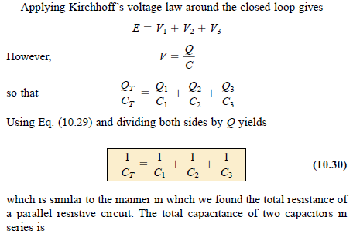
10.13 Capacitors in Series and Parallel

Slide 19
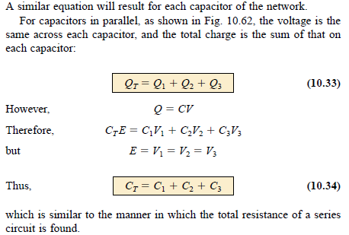
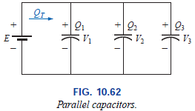
10.13 Capacitors in Series and Parallel

Slide 20
10.13 Capacitors in Series and Parallel
Example: 10.14
Example: 10.15
Example: 10.16
Example: 10.17
Example: 10.18

Slide 21
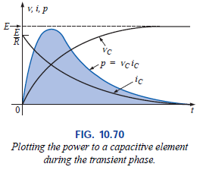
10.14 Energy Stored by a Capacitor
The ideal capacitor does not dissipate any of the energy supplied to it.
It stores the energy in the form of an electric field between the conducting surfaces.
A plot of the voltage, current, and power to a capacitor during the charging phase is shown in Fig. 10.70.
The power curve can be obtained by finding the product of the voltage and current at selected instants of time and connecting the points obtained.
The energy stored is represented by the shaded area under the power curve.

Slide 22
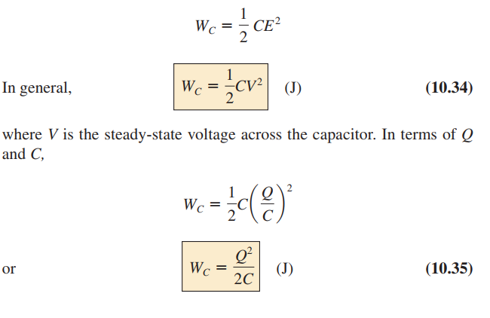
10.14 Energy Stored by a Capacitor
The energy stored is represented by the shaded area under the power curve and using calculus, we can determine the area under the curve:

Slide 23
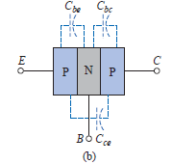
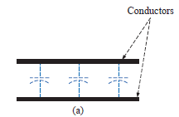
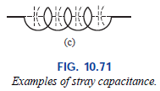
10.15 Stray Capacitance
There are stray capacitances that exist not through design but simply because two conducting surfaces are relatively close to each other.
Two conducting wires in the same network will have a capacitive effect between them, as shown in Fig. 10.71(a).
In electronic circuits, capacitance levels exist between conducting surfaces of the transistor, as shown in Fig. 10.71(b).
Further, we will discuss another element called the inductor, which will have capacitive effects between the windings [Fig. 10.71(c)].
Stray capacitances can often lead to serious errors in system design if they are not considered carefully.

Slide 24
Chapter 11: Inductors

Slide 25
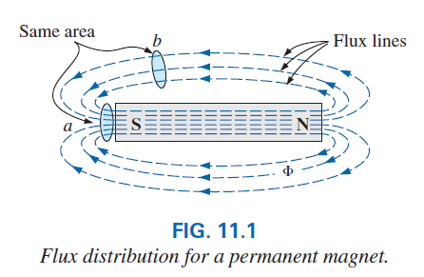
11.2 Magnetic Fields
The permanent magnet is made of a material, such as steel or iron, that will remain magnetized for long periods of time without the need for an source of energy.
In the region surrounding a permanent magnet, there exists a magnetic field, which can be represented by magnetic flux lines similar to electric flux lines.
Magnetic flux lines, however, do not have origins or terminating points as do electric flux lines but exist in continuous loops, as shown in Fig. 11.1.
The symbol for magnetic flux is the Greek letter Φ(phi).
The magnetic flux lines radiate from the north pole to the south pole, returning to the north pole through the metallic bar.

Slide 26
11.2 Magnetic Fields
Note the equal spacing between the flux lines within the core and the symmetric distribution outside the magnetic material.
The strength of a magnetic field in a particular region is directly related to the density of flux lines in that region.
In Fig. 11.1, for example, the magnetic field strength at a is twice that at b since twice as many magnetic flux lines are associated with the perpendicular plane at a than at b.

Slide 27
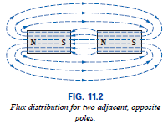
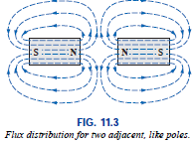
11.2 Magnetic Fields
If unlike/different poles of two permanent magnets are brought together, the magnets attract, and the flux distribution is as shown in Fig. 11.2.
If like poles are brought together, the magnets repel, and the flux distribution is as shown in Fig. 11.3.

Slide 28
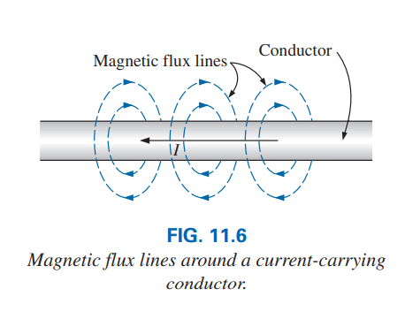
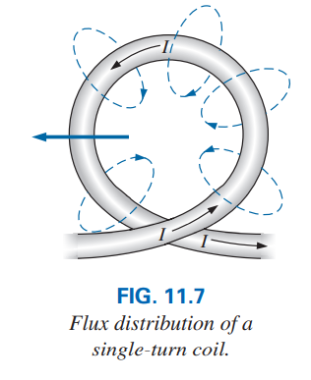
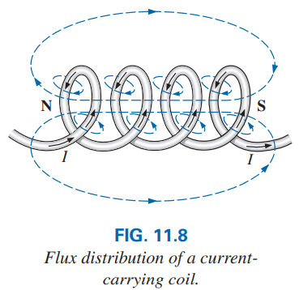
11.2 Magnetic Fields
A magnetic field (represented by concentric(circular) magnetic flux lines) is present around every wire that carries an electric current.
If the conductor is twisted into a single-turn coil (Fig. 11.7), the resulting flux will flow in a common direction through the center of the coil.
A coil of more than one turn would produce a magnetic field that would exist in a continuous path through and around the coil (Fig. 11.8).

Slide 29
11.2 Magnetic Fields
The flux distribution of the coil is quite similar to that of the permanent magnet.
The principal difference between the two flux distributions is that the flux lines are more concentrated for the permanent magnet than for the coil.
Also, since the strength of a magnetic field is determined by the density of the flux lines, the coil has a weaker field strength.
The field strength of the coil can be effectively increased by placing certain materials called a core, such as iron, steel, or cobalt, within the coil to increase the flux density within the coil.

Slide 30
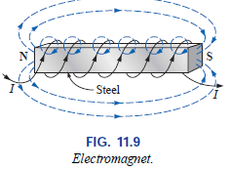
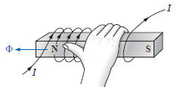
11.2 Magnetic Fields
By increasing the field strength with the addition of the core, we have developed an electromagnet (Fig. 11.9) that, has a field strength that can be varied by changing one of the component values (current, turns, and so on).
Of course, current must pass through the coil of the electromagnet in order for magnetic flux to be developed, whereas there is no need for the coil or current in the permanent magnet.
The direction of flux lines can be determined for the electromagnet by placing the fingers of the right hand in the direction of current flow around the core. The thumb will then point in the direction of the north pole of the induced magnetic flux, as demonstrated in Fig. 11.10(a).

Slide 31
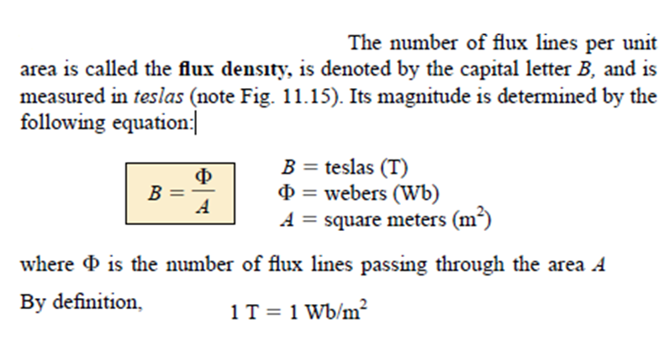
11.3 Flux Density

Slide 32
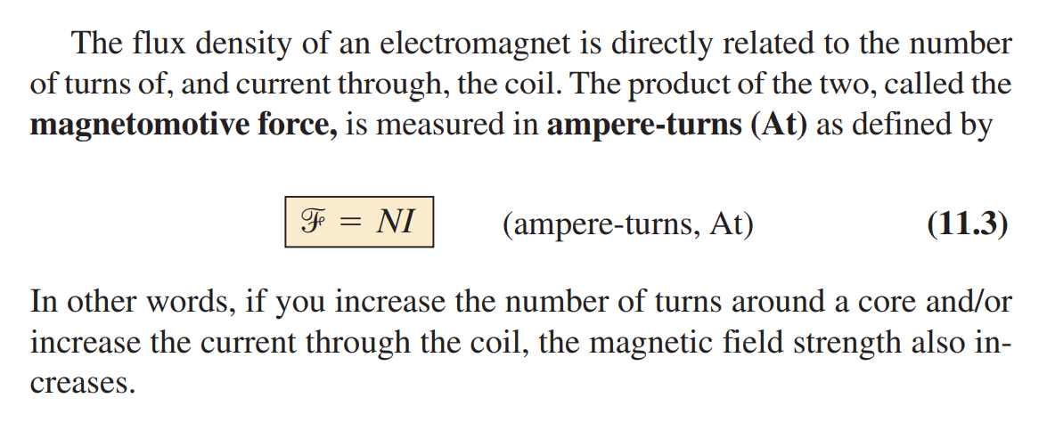
11.3 Flux Density

Slide 33

11.4 Permeability
If cores of different materials with the same physical dimensions are used in the electromagnet, the strength of the magnet will vary in accordance with the core used.
This variation in strength is due to the greater or lesser number of flux lines passing through the core.
The permeability (μ) of a material, therefore, is a measure of the ease with which magnetic flux lines can be established in the material.
Materials in which flux lines can readily be set up are said to be magnetic and to have high permeability.
It is similar in many respects to conductivity in electric circuits. The permeability of free space μ_{o} (vacuum) is

Slide 34
11.4 Permeability
The permeability of all nonmagnetic materials, such as copper, aluminum, wood, glass, and air, is the same as that for free space (vacuum).
Materials that have permeability slightly less than that of free space are said to be diamagnetic
Those with permeability slightly greater than that of free space are said to be paramagnetic.
Magnetic materials, such as iron, nickel, steel, cobalt, and alloys of these metals, have permeability hundreds and even thousands of times that of free space. Materials with these very high permeability are referred to as ferromagnetic.

Slide 35
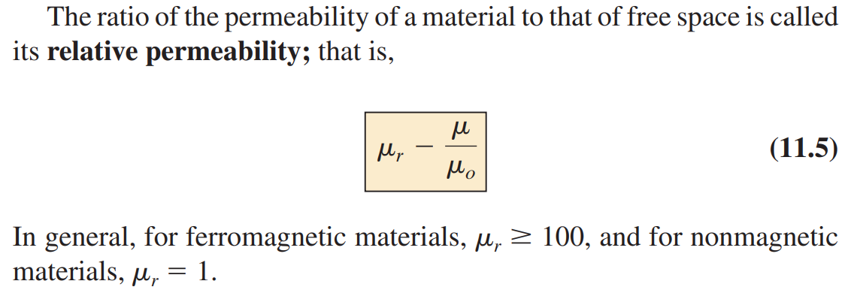
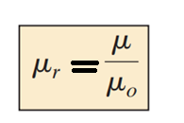
Relative Permeability

Slide 36
Thank You

